Slide 1


VPPIM0514
Notes:
Hello and welcome to today’s presentation, where we will discuss how you may be able to maximize your retirement income with a Transamerica variable annuity and the optional Retirement Income MaxSM rider.

Slide 2
Presented By:
[Registered Representative’s Name]
WITH [FINRA MEMBER FIRM NAME]

Slide 3
Today’s Retiree
Retirement
Savings
Separately Managed Accounts, ETFs,
Mutual Funds
Pensions and
Income Annuities
Deferred Variable Annuity with Guaranteed Income (GMWB)
– How Much to Allocate to Annuities?, Moshe A. Milevsky, PhD. Research Magazine, August 2009
Notes:
You may be utilizing many of these products in an effort to protect your retirement savings. Please keep in mind that securities investments are subject to market fluctuation, investment risk, and possible loss of principal. Today, we are going to talk about variable annuities and the potential benefits of guaranteed income.

Slide 4
Challenges to a Successful Retirement
“80% of Americans believe they will not have enough money for retirement”
Source: U.S. Census Bureau, Saperston Companies, Bankrate, statisticbrain.com, January 1, 2014
Notes:
Many of you in need of income face unprecedented challenges.
Read slide.

Slide 5
Record Amount of Assets in Short-Term Investments
$10.8
In short-term
liquid investments
Trillion
Source: Guide to the Markets, JPMorgan, January 2014
Notes:
One of the challenges you may face includes the record amount of assets in short-term liquid investments.

Slide 6
Interest Rates at Historic Lows
Average Savings Account 0.12%
1-Year CD 0.23%
5-Year CD 0.80%
5-Year Treasury 1.50%
10-Year Treasury 2.71%
Sources: bankrate.com and federalreserve.gov, as of February 18, 2014.
Generally a higher rate of return involves a higher degree of risk.
Notes:
Many of these investments are impacted by the historically low interest rate environment we are currently in.
Read table.

Slide 7
Interest Rates at Historic Lows
“A long spell of low interest rates has created a windfall worth billions to banks, mortgage borrowers and others it was designed to benefit. But for many people who were counting on their nest eggs, those same low rates can spell trouble. The longer the Central Bank keeps interest rates low to stimulate the economy, the more money it pulls out of the pockets of millions of savers.”
– Fed’s Low Interest Rates Crack Retirees’ Nest Eggs, Wall Street Journal, April 4, 2011
Notes:
Read slide.

Slide 8
Interest Rates at Historic Lows
“Among the most vulnerable are retirees, who have few options to restore lost income on investments built up over entire lifetimes.”
“They’re losing their investment income precisely at the time when they need it most.”
– Fed’s Low Interest Rates Crack Retirees’ Nest Eggs, Wall Street Journal, April 4, 2011
Notes:
Read slide.

Slide 9
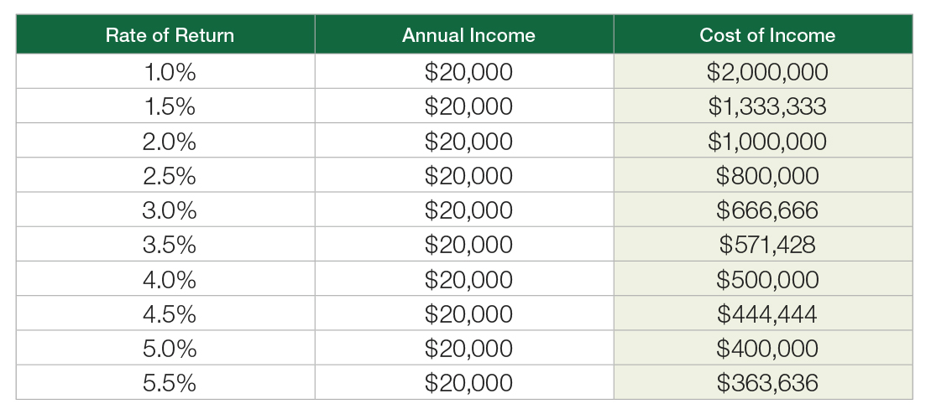
Interest Rates at Historic Lows
What would the Cost of Income be for investments in order to create $20,000 in annual income?
Notes:
The Cost of Income – the amount of capital needed to create income – has changed considerably over the last decade. 10 years ago if you needed $20,000 in annual income and had assets of $490,000, it would have taken almost all of those assets to reach your goal – considering the 10 Year Treasury Yield was at 4.11%*.
Fast forward 10 years. You would need to invest $725,000 to reach your goal of $20,000 in annual income with the 10 Year Treasury Yield at 2.78%**.
The “cost of income” represents how much money would be required to generate an income of $20,000 annually assuming different rates of return. It does not represent the performance of any specific product.
*As of January 27, 2004.
**As of January 27, 2014.
Source: www.treasury.gov/resource-center/data-chart-center/interest-rates/Pages/TextView.aspx?data=yield

Slide 10

Retirement Income Sources are Eroding
Private Sector Pensions Disappearing
out of every 100 workers
had pensions in 1979
out of every 100 workers
had pensions in 2013
Sources: Social Security & Pensions, SmartMoney, October 2011 and Retirement Benefits: Access, Participation, and Take-Up Rates, Private Industry Workers, National Compensation Survey, Bureau of Labor Statistics, March 2013.
Notes:
Additionally, retirement income sources are under strain. Traditional sources of retirement income, including pensions are disappearing.
Read slide.

Slide 11
Retirement Income Sources are Eroding
Social Security Cost of Living Adjustment
Only
1.5%
Increase in Cost of Living Adjustment
Social Security recipients receive
in 2014
Source: Social Security Announces 1.5 Percent Benefit Increase for 2014, www.ssa.gov, October 30, 2013.
Notes:
Social Security is probably something many of you are going to be relying on to help supplement your retirement income. Consider the following.
Read slide.

Slide 12
Retirement Income Sources are Eroding
Social Security Funding Declining
Year
2033
The government appointed Board of
Trustees estimate of when the Social
Security program will not be able to pay
100% of promised benefits
Source: Social Security Board of Trustees: No Change in Projected Year of Trust Fund Reserve Depletion, www.ssa.gov, May 31, 2013.
Notes:
Also, the funding for Social Security is declining. In fact, by 2033 the Treasury Department estimates that the Social Security program will not be able to pay 100% of promised benefits.

Slide 13
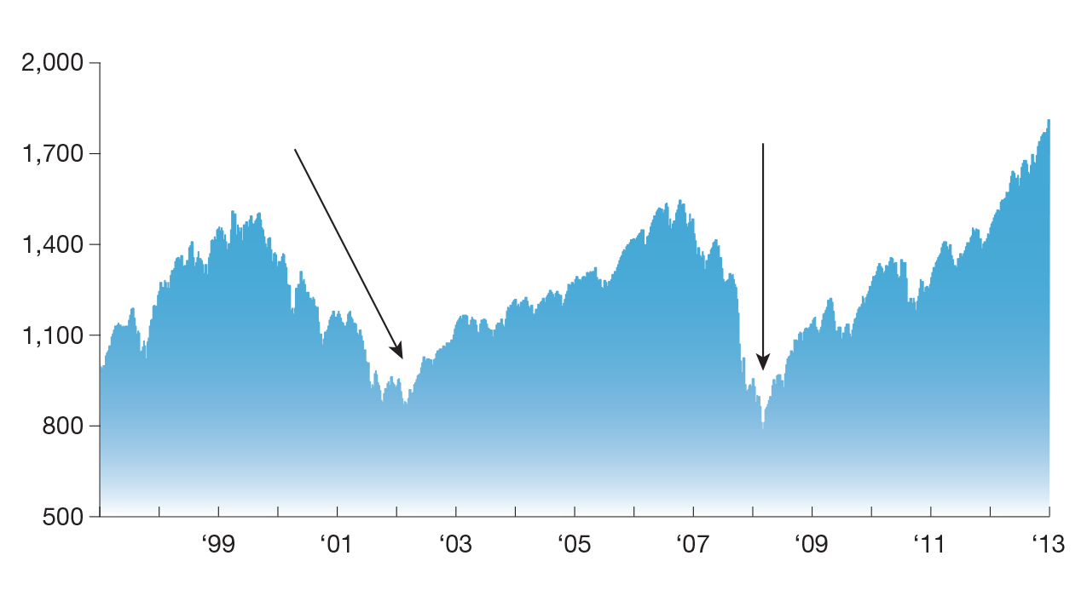
Equity Markets are Unpredictable
Trillions Lost Overnight
U.S. Retirement Assets Lost in Two Market Collapses
$1.4 trillion lost
$3.7 trillion lost
S&P 500® chart derived from Yahoo! Finance data. Past performance is no guarantee of future results.
Source: US Retirement Markets and Retirement Assets Total $17 Trillion in Third Quarter 2011, ici.org.
Notes:
Another concern for you may be how unpredictable the equity markets have been. This market volatility has had a major impact on your retirement assets.

Slide 14
Inflation’s Impact is Underestimated
A Conservative
2.3% Inflation Rate
$1.00
Today will be worth
$.80
In 10 years
But keep in mind, the inflation rate over
the past 30 years has averaged 4.3%
$.63
In 20 years
$.51
In 30 years
Sources: Inflation: Fourth Quarter 2013, Survey of Professional Forecasters, November 25, 2013 and www.calculator.net/interest-calculator.html and www.calculator.net/inflation-calculator.html.
Notes:
Inflation also remains a concern for many of you.
Read slide.

Slide 15

Health Care Costs Increasing
Medical Expenses are Skyrocketing
Consider, it is estimated that a 65-year-old couple today will need $220,000 for medical expenses throughout retirement, not including nursing home care.
$220,000
$160,000
2002
2013
38% increase in costs since 2002
Source: Fidelity Estimates Couples Retiring In 2012 Will Need $240,000 To Pay Medical Expenses Throughout Retirement, fidelity.com,
May 9, 2012 and Fidelity Estimates Couples Retiring In 2013 Will Need $220,000 To Pay Medical Expenses Throughout Retirement, fidelity.com, May 15, 2013.
Notes:
Finally, health care costs and medical expenses continue to rise.
Read slide.

Slide 16
A Retirement Income Solution
The Opportunity to Create:
A guaranteed income stream for life
The ability to stay invested in equities
Income protection when the market goes down
Income growth when the market goes up
Income stability during periods of low rates
Flexibility to start and stop income
Your own personal pension
Here’s How…
Any withdrawals, including those permitted under the rider, reduce your variable annuity’s policy value, death benefits and other values. Withdrawals may be subject to surrender charges.
All guarantees, including optional benefits, are backed by the claims-paying ability of the issuing insurance company.
Notes:
Click for animation.
All of these potential concerns leads to an opportunity to help you in retirement.
Read slide.
Now, we’ll explain how we can help you grow and protect your retirement income.
All guarantees, including optional benefits, are backed by the claims-paying ability of the issuing insurance company.

Slide 17
Variable Annuities
Pension
Stocks
and
Bonds
VA
Notes:
Most of you probably like the upside potential of investments such as stocks, bonds, and mutual funds to help maintain your lifestyle. Obviously, you do not like the downside. And maybe you understand the need for reliable income similar to what a pension can provide. In an uncertain market environment, the popularity of variable annuities with a living benefit sits somewhere in between, because they contain aspects of both reliable income and upside growth potential to the withdrawal base to maintain your lifestyle in retirement.

Slide 18
Variable Annuities
How They Work
Stocks
and
Bonds
VA
VA
VA
Notes:
Click for animation.
In an up-market environment, variable annuities with a living benefit provide growth potential to the withdrawal base as selected investment options perform well.

Slide 19
Variable Annuities
How They Work
Pension
Stocks
and
Bonds
VA
VA
VA
All guarantees, including optional benefits, are backed by the claims-paying ability of the issuing insurance company.
Notes:
Click for animation.
In a down-market environment, variable annuities with a living benefit rider like the Retirement Income MaxSM rider swing toward the pension side due to the guarantees they provide - including reliable steady income for life to help you in retirement.

Slide 20

The Retirement Income MaxSM Rider
Maximize Your Retirement Income
Step-Ups
MonthiversarySM
Automatic
Income
For Life*
Single Life Withdrawals
  6.30% at age 80+
  5.30% at age 65-79
  4.30% at age 59-64
Growth
5.5% Annual Compounding
Investments
Multiple Investment Options
*If the rider is structured as joint life, the withdrawal percentages are 0.30% lower and are based on the younger of the annuitant or the annuitant’s spouse when withdrawals begin.
Notes:
The Retirement Income MaxSM rider is an optional living benefit, available for an additional cost with Transamerica variable annuities. It may help you maintain your lifestyle in retirement by maximizing your retirement income by offering opportunity to the withdrawal base in up-markets and protection when the market is down. Retirement Income MaxSM does this with four notable features that we’ll illustrate now.

Slide 21
Automatic Step-Ups – Opportunity in Up Markets
“There is no significant difference among daily, weekly, and monthly step-ups.”
– Allocation to Deferred Variable Annuities with GMWB for Life, Journal Of Financial Planning, February 2010.
Notes:
Read slide.
Next, we’ll discuss the automatic step-up feature of the Retirement Income MaxSM rider.

Slide 22
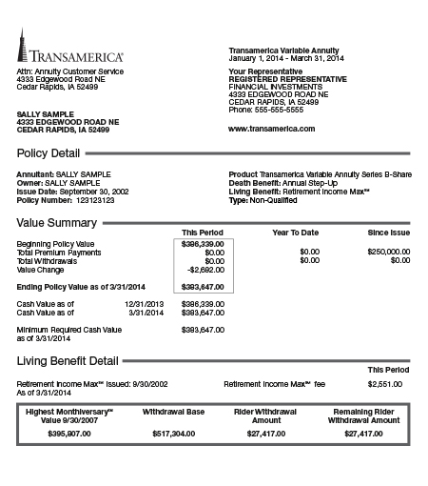

Step-Ups, MonthiversarySM, Automatic
Opportunity In Up Markets
Every month matters
1
2
3
4
5
6
7
8
9
10
11
12
Notes:
At Transamerica, we give you 12 opportunities every year to lock in your highest monthly value- regardless if they’re taking withdrawals or not.
Here’s how: Each year on the rider anniversary, we look back at your 12 monthly policy values on the date you purchased the rider – your MonthiversarySM. We then lock in the highest of those values and Automatically Step-Up your Withdrawal Base to this new value. Your Withdrawal Base, also referred to as retirement income base, is used to calculate the amount of retirement income (rider withdrawal amount) you can receive.
Every month matters.
For example: I assume you receive statements on most of your financial holdings on a monthly basis.
Your statements probably show a closing balance, a snapshot of the value of your account on a particular day. How many of you probably remember which month had the best closing balance?
Your best month could occur anytime during the year. In this example the ninth month was the best month. We would lock in this value to your retirement income base.

Slide 23
Every Month Matters
“The Dow Jones Industrial Average closed up 7.80
points, or 0.07% at 11,577.51, up 11% from where it began in 2010. The Dow’s gain for the year represents its second-straight annual increase, with almost half of the 2010 climb having come this month; it rose 5.20% in December.”
— Stocks Round Out Strong Month, Quarter, CBS MarketWatch.com, December 31, 2010
Notes:
Read slide.

Slide 24
Every Month Matters
April 29, 2011
“U.S. stocks rose Friday, and posted gains for the week and the month of April, with a climb in shares of Caterpillar Inc. helping push the DJIA up 47.23 points, or 0.4%, higher to 12,810.54. For the week, the Dow rose 2.4% and finished April up 4%, its heftiest monthly rise since December.”
— U.S. stocks rise Friday; Dow Climbs 4% in April, CBS MarketWatch.com
Notes:
Read slide.

Slide 25
Every Month Matters
October 31, 2011
“The Dow soared 9.5% last month, its best month since October 2002. Measured by points, the 1,041.63 point rise was its biggest ever. ”
— A Month to Remember for Markets, The Wall Street Journal
Notes:
Read slide.

Slide 26
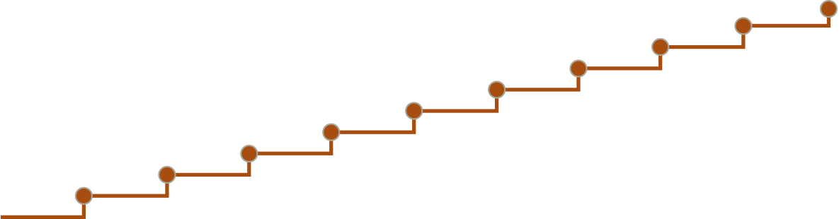

5.5% Annual Compounding Growth
Protection in Down Markets
Policy Value and Withdrawal Base
0
1
2
3
4
5
6
7
8
9
10
Rider Year
Withdrawal Base
5.5% Guaranteed Growth
Policy Value
This is a hypothetical illustration intended to illustrate the features of the Retirement Income MaxSM rider. This illustration does not guarantee or predict actual performance.
All guarantees, including optional benefits, are backed by the claims-paying ability of the issuing insurance company.
Notes:
Next, let’s discuss growth. You have earned your retirement income; we can help you protect it. For up to 10 years, if you do not receive an Automatic Step-Up and no withdrawals are taken in the current rider year, we’ll provide 5.5% annual compounding growth to your Withdrawal Base. And, if your Withdrawal Base received an Automatic Step-Up in the previous year, your 5.5% growth will be based on that amount.

Slide 27
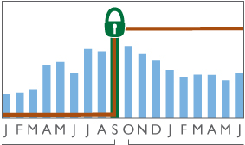
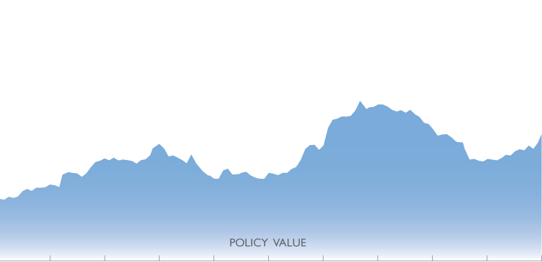


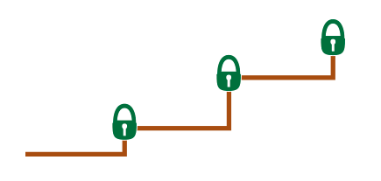
Growth On Growth
Growing And Protecting Your Retirement Income
MonthiversarySM in action
The rider was purchased September 30th and
the policy value was recorded every month
thereafter on the same date. In this case,
September 30th was the highest MonthiversarySM
DOWN MARKETS
Receive 5.5% annual
compounding growth
to your clients withdrawal base
for up to 10 years*
UP MARKETS
Automatically lock-in
the highest MonthiversarySM
value and step-up your clients
withdrawal base
Withdrawal Base
Initial
Investment
0
1
2
3
4
5
6
7
8
9
10
Year
This illustration does not guarantee or predict actual performance.
* Assumes no withdrawal is taken in the rider year.
Notes:
Click to animate. Working together, these two features offer you growth-on-growth potential.
Click to animate. The example above illustrates how the growth-on-growth component allows you the opportunity to grow your future retirement income by automatically stepping up your Withdrawal Base in up markets, and receiving 5.5% annual compounding growth on your Withdrawal Base for up to 10 years, in flat or declining markets.
Click to animate. Compounding growth only applies in rider years when withdrawals are not being taken.
The Automatic Step-Ups and 5.5% growth rate apply only to the Withdrawal Base; they do not apply to policy value, optional death benefits, or other optional benefits.

Slide 28
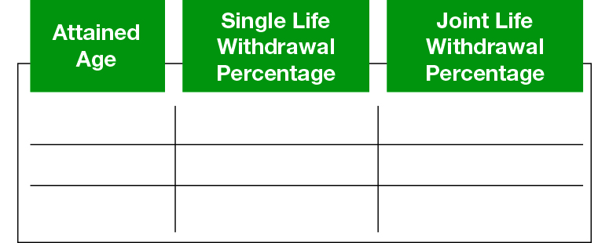
Maximize Your Retirement Income
80+
6.30%
6.00%
65-79
5.30%
5.00%
59-64
4.30%
4.00%
If the rider is structured as joint life, withdrawals are based on the younger of the annuitant or the annuitant’s spouse
when withdrawals begin and may be changed with an automatic step-up.
All guarantees, including optional benefits, are backed by the claims-paying ability of the issuing insurance company.
Notes:
With the Retirement Income MaxSM rider, the maximum withdrawal percentage used to determine your annual retirement income, also referred to as rider withdrawal amount, is an important feature to consider. Retirement Income MaxSM provides maximum withdrawal percentages, also referred to as withdrawal rates, which may help you achieve the retirement income you desire. We guarantee income for the rest of your life. We calculate your retirement income amount by taking your withdrawal percentage and multiplying it by the Withdrawal Base.
We also provide the opportunity for your retirement income amount to increase, and we do this in two ways: First, even after you start taking withdrawals, your Withdrawal Base will increase anytime you receive an Automatic Step-Up. Secondly, your annual withdrawal percentage will increase anytime you receive an Automatic Step-Up and enter a new age group.

Slide 29
Important Information
TA Asset Allocation - Moderate Performance Update March 31, 2014
TA Asset Allocation – Moderate TST – Service Class (5/1/02) | 1 Year | 5 Years | 10 Years
Portfolio returns without surrender charges and service charges deducted | 7.64% | 10.77% | 4.26%
Subaccount returns with surrender charges and service charges deducted | -0.21% | 10.74% | 4.22%
The performance quoted represents past performance and does not guarantee future results; current performance may be lower or higher than the performance quoted. The annuity value will fluctuate with market conditions so that when surrendered, it may be worth more or less than the total of premium payments. To obtain performance data current to the most recent month-end go to www.transamerica.com.
The performance displayed without surrender charges reflects the portfolio returns assuming a single premium payment (date next to portfolio name) with the Annual Step-Up death benefit, are net of all asset-based fees, including the daily Mortality and Expense Risk fee and Administrative charge equal to 1.50% annually, 12b-1 fees, (if any) and all other actual portfolio expenses. The performance displayed with surrender charges reflect the subaccount returns assuming a single premium payment with the Annual Step-Up death benefit, are net of all asset-based fees, including the daily Mortality and Expense Risk fee and Administrative charge equal to 1.50% annually, annual service charge, maximum surrender charge (8%), 12b-1 fees, (if any) and all other actual portfolio expenses. Neither include any charges for other optional riders or any taxes that may apply at distribution. If they had, performance would be lower. The figures in the tables may reflect waiver of advisory fees and reimbursement of other expenses. In the absence of such waivers, the performance would have been lower.
Notes:
Read slide.

Slide 30
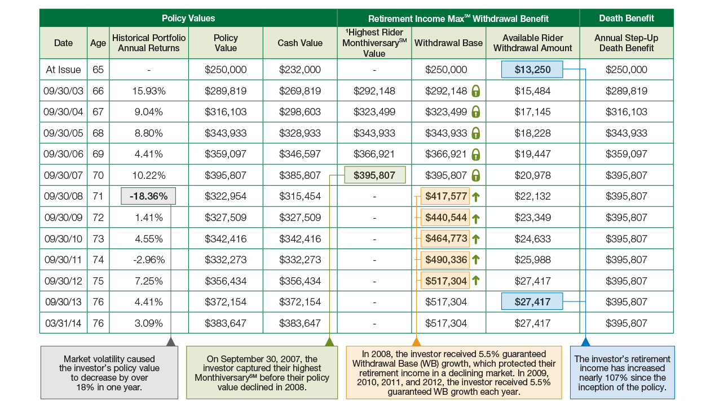


Opportunity in Up Markets Protection in Down Markets
Hypothetical Scenario Based on Historical Performance
On September 30, 2007, the
investor captured their highest MonthiversarySM before their policy
value declined in 2008.
$395,807
In 2008, the investor received 5.5% guaranteed Withdrawal Base (WB) growth, which protected their retirement income in a declining market.
In 2009, 2010, 2011, and 2012, the investor received 5.5% guaranteed WB growth each year.
$417,577
Market volatility caused
the investor’s policy value
to decrease by over
18% in one year.
The investor’s retirement income has increased nearly 107% since the inception of the policy.
$440,544
-18.36%
$13,250
$464,773
$27,417
$490,336
$517,304
*No value is displayed when the highest MonthiversarySM value for the rider year is less than (1) the withdrawal base and (2) the highest MonthiversarySM value since rider inception. Increase due to an Automatic Step-Up. Increase due to 5.5% Growth Feature. The Withdrawal Base does not establish or guarantee policy value, cash value, minimum death benefit, or return for an investment option. The illustration is intended to help you understand how historical performance of TA Asset Allocation – Moderate TST – Service Class would affect the values and benefits of this annuity and rider. This illustration does not guarantee or predict actual performance. The historical portfolio annual returns reflect year-end values that are net of all fees and charges except surrender charges, income tax and, if applicable, state premium tax. The Historical Portfolio Annual Returns, Policy Value, and Cash Value columns reflect the deduction of the annual 1.50% M&E&A charge for the Annual Step-Up death benefit, and investment option management fee. They are further reduced by the initial annual rider fee percentage of 1.25% of the Withdrawal Base for the initial rider year and then an additional maximum 0.75% thereafter. The Retirement Income MaxSM rider was not available for purchase until February 21, 2011.
Notes:
Showing how these features work together, here is a hypothetical example of the Retirement Income MaxSM rider in action using historical performance.
This hypothetical investor was age 65 when they purchased a Transamerica Variable Annuity Series B-Share issued by Transamerica Life Insurance Company (Transamerica) and added the optional Retirement Income MaxSM rider. The investor allocated 100% of their $250,000 premium to the TA Asset Allocation – Moderate TST – Service Class investment option. No withdrawals have been taken from the policy. If withdrawals had started in any of these years, the available rider withdrawal amount would change. Other investment options may have different returns and please see the performance table on slide 29 for performance of the TA Asset Allocation – Moderate TST – Service Class.
The performance of the investment option (TA Asset Allocation – Moderate TST – Service Class) drives the policy value which determines the withdrawal base. Remember the slide where the 9th month statement appeared? On September 30, 2007, the 9th month, the highest MonthiversarySM that was captured and it is the green shaded number. Then the crash of 2008 happened and we saw an over 18% decline for the investment option, which set the stage for protection in down markets with the rider’s 5.5% guaranteed growth.
The rider captured the highest MonthiversarySM, $395,807, and added 5.5%, growth on growth, for a new withdrawal base, the orange shaded number, of $417,577. 5.5% growth was added again in 2009, 2010, 2011, and 2012, for a new withdrawal base of $440,544, $464,773, $490,336, and $517,304, respectively. In ten years the withdrawal base grew nearly 107% and what does this mean to you? It means your retirement income, the available rider withdrawal amount, also grew nearly 107% from $13,250 to $27,417. Here’s how your retirement income works, since our hypothetical investor is 65, they are in the 5.3% withdrawal age group based on single life and will receive 5.3% of the withdrawal base.
Policy Value – The Policy Value is equal to the owner’s premium payments less any gross partial surrenders and reflects the gains and/or losses of the selected investment option(s). The Policy Values in the illustration reflect the deduction of the M&E&A charge, investment option management fee, and rider fee.
Cash Value – The Cash Value reflects the deduction of surrender charges from the Policy Value that apply during the seven years following the date of each premium payment of 8%, 8%, 7%, 6%, 5%, 4%, 3%, respectively, and 0% thereafter and represents the amount you would receive if you surrendered your contract at the end of each policy year.
Annual Step-Up Death Benefit – The Annual Step-Up Death Benefit represents the value the beneficiary would receive upon the death of the annuitant. The Death Benefit is equal to the greatest of the Policy Value, Cash Value if applicable in your state, or the Annual Step-Up Death Benefit. The Annual Step-Up Death Benefit is equal to the largest Policy Value on any policy anniversary, plus premiums and less any adjusted partial withdrawals that occur after the highest anniversary. Available for issue ages through age 75 and step-ups stop at age 81. Death Benefit proceeds are taxable as ordinary income when paid to the beneficiary.
Withdrawal Base – The Withdrawal Base (WB) is equal to the policy value when the rider is added, plus any additional premiums, and less any adjustments for excess withdrawals after the rider is added. The WB is used to determine the rider withdrawal amount and the amount of the rider charge. The WB does not establish or guarantee policy value, surrender value, minimum death benefit, or return for an investment option.
Excess withdrawals – Withdrawals in excess of the maximum percentage allowed under the rider will result in a decrease in the dollar amount of future withdrawals available under the rider. The rider MonthiversarySM component of Automatic Step-Ups is not considered in rider years when an excess withdrawal has been taken.

Slide 31
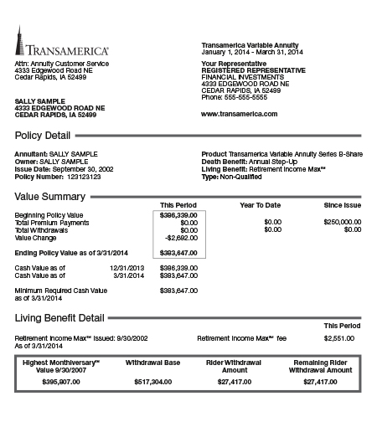
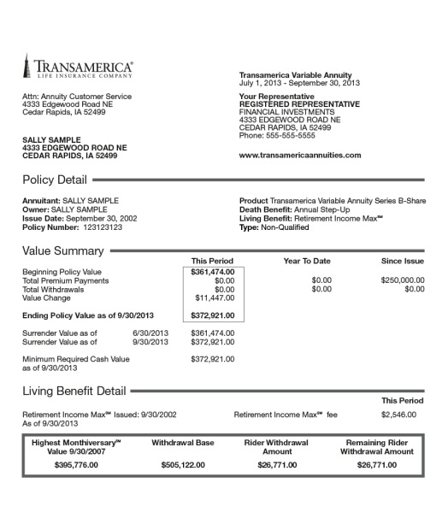
September 30, 2002
This is the date the annuity was issued. On the
same day each month (the 30th or following business day), this investor’s policy value will be recorded by Transamerica. This is called the investor’s MonthiversarySM value.
Opportunity in Up Markets Protection in Down Markets
$250,000.00
This is the premium the investor paid into the annuity and their initial Withdrawal Base (WB).
Every month matters
1
2
3
4
$383,647.00
This is the investor’s current policy value, based on the performance of their chosen investment option since the annuity was issued.
5
6
7
8
9
Statement Summary: Automatic Step-Up Increase Opportunities Can Be Beneficial
Withdrawal Base* since inception: $250,000.00 $517,304.00 = 106.92% Increase
Policy value since inception: $250,000.00 $383,647.00 = 53.46% Increase
*This is the amount used to calculate the rider withdrawal amount. It cannot be taken as a lump sum.
10
$395,807.00
This is the investor’s Highest Rider MonthiversarySM Value since the rider inception which was captured on September 30, 2007.
11
12
$517,304.00
This is the investor’s WB, which is used to determine
their guaranteed retirement income. The WB is guaranteed to never decrease in value unless the investor takes an excess withdrawal.
$27,417.00
Once the investor begins withdrawals, this is the investor’s available retirement income amount to withdraw until the next rider anniversary date.
$27,417.00
This is the investor’s guaranteed retirement income for life, even if the policy value falls to zero, unless the investor takes an excess withdrawal.
Results are hypothetical and based on historical performance. They do not represent investment results of any particular investor.
All guarantees, including optional benefits, are backed by the claims-paying ability of the issuing insurance company.
Notes:
Everyone remembers the animated slide that showed 12 months of statements, correct? Here’s what a statement looks like based on the numbers I showed you from the previous slide and we’re showing the third statement because it reflects the first quarter of 2014.
Read slide.
Statement summary: as you’ll notice, the WB increased nearly 107% and the policy value, even in volatile markets over the last 11years, has increased over 53% since inception.

Slide 32








Investment Options
Well Known Managers
Vanguard, the ship logo, and Vanguard ETFs are trademarks of The Vanguard Group. Vanguard is one of the managers of the underlying ETFs.
The investment objectives and policies of certain funds may be similar to those of other funds managed by the same investment advisor. No representation is made, and there can be no assurance given, that any fund’s investment results will be comparable to the investment results of any other fund, including another fund with the same investment advisor or manager.
The investment options are subject to market fluctuation, investment risk, and possible loss of principal.
Notes:
Well known money managers professionally manage the investment options available with the Retirement Income MaxSM rider. You will know your retirement is being managed by experienced professionals.
You must allocate 100% of your policy value into one or more of the designated investment options. Transamerica can remove a designated investment option at any time for both new and existing contracts.

Slide 33
The Retirement Income MaxSM Rider Fee
SINGLE OR JOINT LIFE FEE
1.25%
ISSUE AGES*
0-85
*Issue ages in New York are 58-85 for Single Life and 65-85 for Joint Life.
Rider fee as of May 1, 2014. The rider fee is deducted on each rider quarter in arrears, and is an annual percentage of the Withdrawal Base. The rider fee percentage may increase upon an Automatic Step-Up beginning with the first rider anniversary, but the maximum rider fee percentage allowed is 0.75% higher than the initial rider fee percentage.
Because the rider fee is a percentage of the Withdrawal Base, the amount of the fee will fluctuate as the Withdrawal Base increases
or decreases. Even in the event your policy value declines significantly, the fee amount could be a much higher percentage of your policy value.
Notes:
Read slide.

Slide 34
Mainstream Recognition
“Also, given the markets’ volatility, look for an annuity that evaluates whether to reset the floor frequently. One Transamerica Corp. product looks at monthly market benchmarks, and uses the month with the best performance each year to calculate a new baseline for an account’s value and payments,” says Jim Otar, engineer and CFP from Thornhill, Ontario.
– Which Way to Retirement?, Wall Street Journal, August 12, 2011
Notes:
Read slide.
When Mr. Otar mentions “an account’s value” he is referring to the Withdrawal Base.

Slide 35
Mainstream Recognition
“As insurance companies continue de-risking their annuity products, by effectively reducing guarantees, only a handful of companies marketing guaranteed lifetime withdrawal benefits (GLWBs) offer true protection against longevity, sequence of return and (potentially) inflation risk. I believe one of them is Transamerica.”
– “Transamerica Principium II,” Moshe A. Milevsky, Research Magazine, January 2011
All guarantees, including optional benefits, are backed by the claims-paying ability of the issuing insurance company.
Notes:
Read slide.

Slide 36
Retirement Income MaxSM Rider
Maximize Your Retirement Income
Step-Ups
MonthiversarySM
Automatic
Income
For Life*
Single Life Withdrawals
  6.30% at age 80+
  5.30% at age 65-79
  4.30% at age 59-64
Growth
5.5% Annual Compounding
Investments
Multiple Investment Options
*If the rider is structured as joint life, the withdrawal percentages are 0.30% lower and are based on the younger of the annuitant or the annuitant’s spouse when withdrawals begin.
Notes:
As we’ve discussed, the Retirement Income MaxSM rider is an optional living benefit available with a Transamerica variable annuity. It may help you maintain your lifestyle in retirement by maximizing your retirement income by offering opportunity to the withdrawal base in up-markets and protection when the market is down. Again, these are the four features that distinguish Retirement Income MaxSM.

Slide 37
Important Information
Before investing, consider a variable annuity's investment objectives, risks, charges, and expenses. Call
1-800-525-6205 for a contract and fund prospectus containing this and other information. Please read it carefully.
Fees
Transamerica variable annuities’ range of fees and charges include 0.45%-1.90% Mortality and Expense Risk fee and Administrative charges (M&E&A),
0%-9% surrender charges, $50 annual service charge, and investment option management fees. A fund facilitation fee of up to 0.30% may apply for certain investment options.
What is a Variable Annuity?
Variable annuities are long-term financial vehicles designed for retirement purposes.
The variable annuity policy value, death benefit, and other values will fluctuate based on the performance of the investment options and may be worth more or less than the total of all premiums paid when surrendered.
Withdrawals
The Automatic Step-Ups and 5.5% growth rate apply only to the Withdrawal Base; they do not apply to policy value, optional death benefits, or other optional benefits. In years when a withdrawal is taken, the 5.5% compounded growth does not apply.
You must wait until the rider year after you turn age 59 to begin withdrawals permitted under the rider. If the rider is purchased prior to age 59, however, the rider fee will still apply.
Withdrawals may be subject to surrender charges. Should the variable annuity’s policy value fall to zero, you will receive payments up to the amount allowed under the rider for life. If an excess withdrawal causes the policy value to reach zero, the rider and policy will terminate. Withdrawals in excess of the rider withdrawal amount will result in a decrease in the dollar amount of future withdrawals available under the rider.
Withdrawals of taxable amounts are subject to ordinary income tax and may be subject to a 10% additional federal tax if withdrawn before age 59½.
On the maximum annuity commencement date, the rider terminates. By annuitizing the policy, you will have the option to receive lifetime payments that are no less than the withdrawals allowed by the rider. Annuitization must generally occur by the annuitant’s age 99.
Additional Information
All contract and rider guarantees, including optional benefits and any fixed subaccount crediting rates or annuity payout rates, are backed by the claims-paying ability of the issuing insurance company. They are not backed by the broker/dealer from which this annuity is purchased, by the insurance agency from which this annuity is purchased, or any affiliates of those entities, and none makes any representations or guarantees regarding the claims-paying ability of the issuing insurance company.
You have the right to reject an Automatic Step-Up within 30 days following a rider anniversary, if the rider fee percentage increases. If you reject an Automatic Step-Up, you must notify us in a manner which is acceptable to us, however you are still eligible for the 5.5% growth feature and future Automatic Step-Ups. Changes as a result of the Automatic Step-Up feature will be reversed. Any increase in the rider fee percentage will also be reversed, and the Withdrawal Base will be set to the Withdrawal Base prior to the Automatic Step-Up.

Slide 38
Important Information
Additional Information
Financial institutions that sell our products may have their own guidelines to determine suitability of our variable annuity policies and/or riders. Some financial institutions may not sell all of our products, may have specific issue ages for our variable annuity policies, and may not have all living and death benefits available.
The TA Asset Allocation – Moderate TST – Service Class investment strategy is intended to smooth out investment performance spikes. Performance gains may not be as strong as might by available in benchmark indices or comparable funds not using volatility controls.
The ability of the TA Asset Allocation – Moderate TST – Service Class fund to achieve its objective depends largely on the performance of the underlying fund in which it invests. Each underlying fund’s performance, in turn, depends on the particular securities in which that underlying funds invests. Total expenses associated with the fund may be higher than with other mutual funds.
For federal tax purposes, married same sex individuals are recognized as “spouses”. The IRS has adopted a rule providing that the term “spouse” does not include an individual who has entered into a registered domestic partnership, civil union, or other similar relationship. The status of these relationships for state purposes may vary based on the applicable state law. Transamerica intends to administer variable annuity contracts consistent with the IRS rulings until further notice. Please contact a qualified tax advisor prior to purchasing to discuss how exercising spousal continuation benefits under this contract or any riders will affect you for both federal and state tax purposes. Please see prospectus for more details.
All policies, riders, and forms may vary by state, and may not be available in all states. ICC12 VA0513, NIC12 VA0513(FL), NIC12 VA0513(NY), ICC12 RGMD50513, NIC12 RGMD50513, NIC12 RGMD50513(NY), ICC12 RGMB410513(IS), ICC12 RGMB410513(IJ), RGMB 41 0111 (IS) (FL), RGMB 41 0111 (IJ) (FL), RGMB 41 0514R (IS)(NY), RGMB 41 0514R (IJ)(NY)
Transamerica Financial Life Insurance Company is licensed in New York.

Slide 39
Questions???
Thank You For Your Time

